Slide 1
30 RNA seq samples
Differential gene expression analysis
Data: Normalized reads mapped to annotated genes
Tool: EdgeR in R

Slide 2
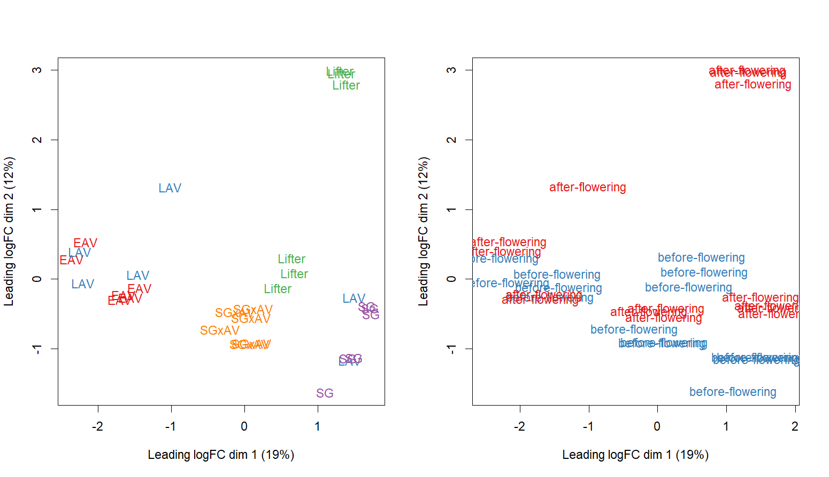
Variation among samples

Slide 3
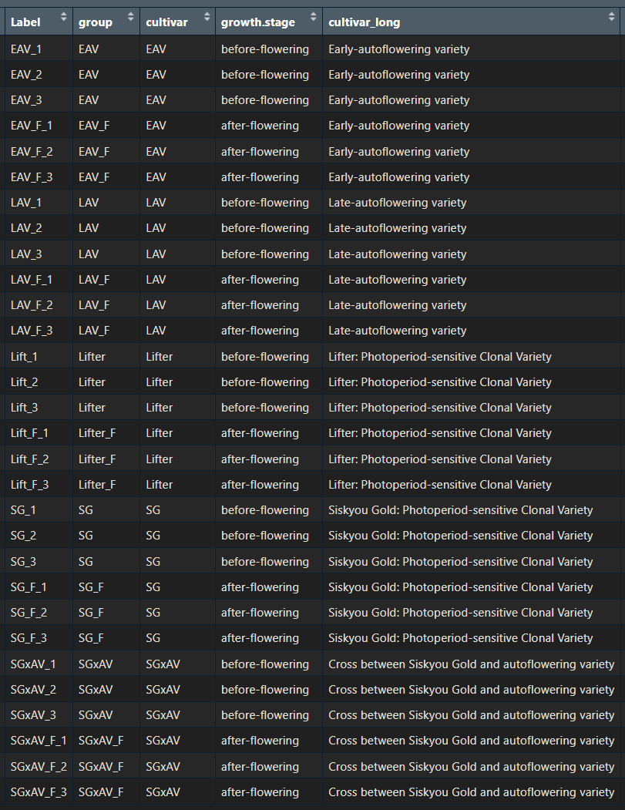
Does SGxAV cultivar show more similar DGE patterns to EAV or SG cultivar?
A case study:
What genes are differentially expressed before and after flowering in EAV and SG cultivars?
Among those genes, what are the unique genes expressed comparing EAV and SG cultivars?

Slide 4
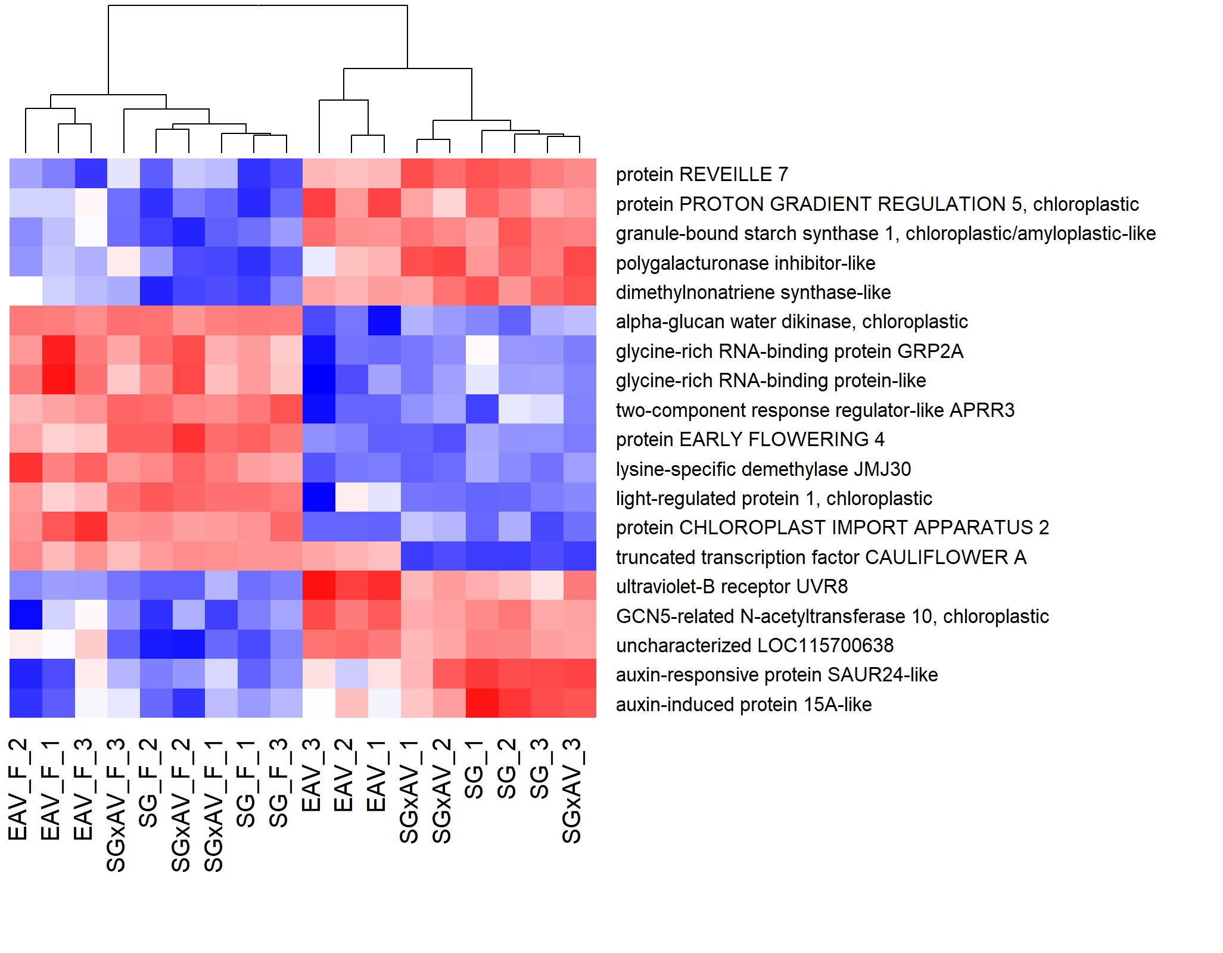
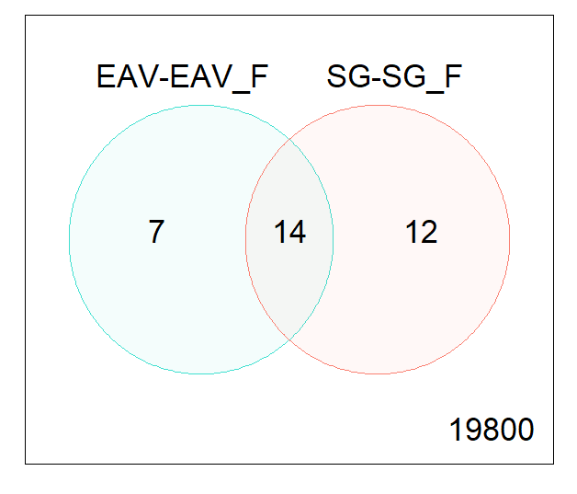
Does SGxAV cultivar show more similar DGE patterns to EAV or SG cultivar?
DEG: log₂FC >= 1
at least two folds expression level change
EAV vs EAV_F
SG vs SG_F
Down and up regulated genes:
Total = 33
Unique to EAV vs EAV_F = 7
Unique to SG vs SG_F = 12
Common = 14
19 genes
SGxAV shows more similar expression patterns as a SG cultivar

Slide 5
Next steps:
Compare more sample ‘pairs’:
What differentiates an auto- and sensitive flowering cultivar?
What observed (and interested) traits are very different among the cultivars? E.g., flowering onset, stem elongation, etc.
Understand the DGE patterns show significant differences among the comparisons

